Slide 1

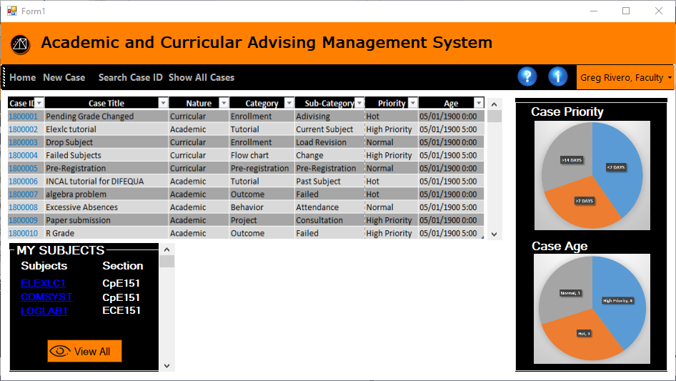

Faculty Home Page: Retrieving Cases
Academic and Curricular
Advising Management System
Academic and Curricular advising Management System

Slide 2
Faculty Home Page: My Subjects (Quick Links)
Academic and Curricular
Advising Management System
Academic and Curricular advising Management System

Slide 3
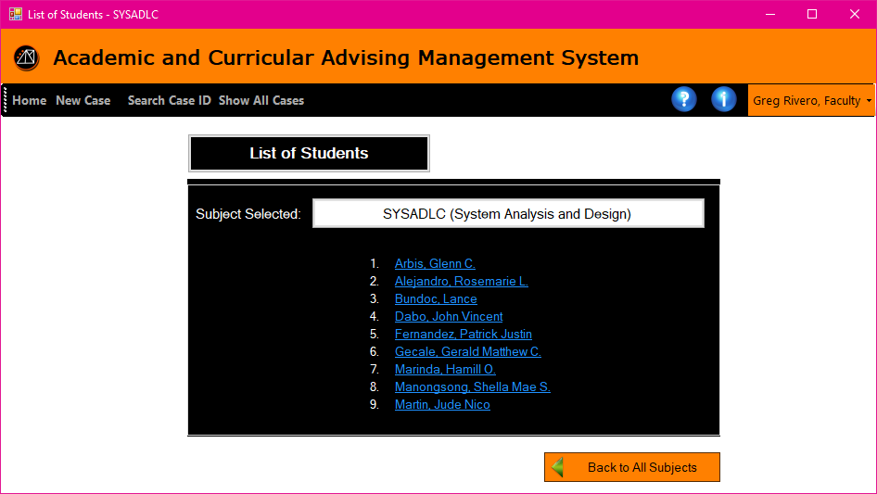
After clicking a subject from the quick links from the Faculty Homepage
Academic and Curricular
Advising Management System
Academic and Curricular advising Management System

Slide 4
Faculty Home Page: Show All Cases (From the Tool strip)
Academic and Curricular
Advising Management System
Academic and Curricular advising Management System

Slide 5
Faculty Home Page: Search Case ID
Academic and Curricular
Advising Management System
Academic and Curricular advising Management System

Slide 6
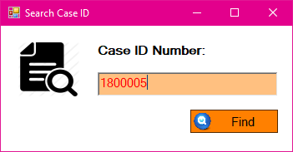
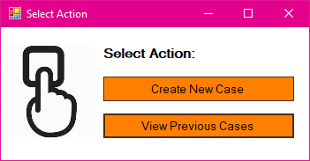
Search Case ID popup and Select Action popup
Academic and Curricular
Advising Management System
Academic and Curricular advising Management System

